Slide 1
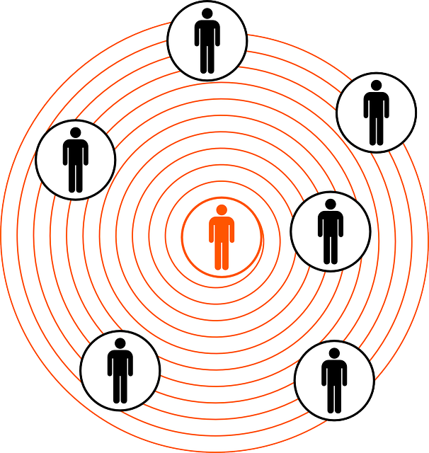
From Vertices to Edges
Focus so far on Vertices (Nodes)
  Actors/Agents
  Property of Agent linked to network property:
    Centrality
    Composition
    Diversity
    Density

Slide 2
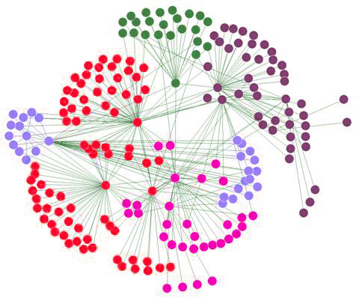
From Vertices to Edges
Recall the definition of a network:
  G = (V, E) with N vertices and M Edges
  What about the edges (dyads)?
Critical for dynamic analysis
  Tie formation and persistence (or decay)
  Flows and weighted edges based on interaction events
  Generative processes - network evolution

Slide 3
The Problem
Binary data (presence/absence)
Dyadic Census - 3 states:
  Null Dyad
  Asymmetric Dyad
  Mutual Dyad
Prior work:
  Mutuals persist, asymmetric tend to null than mutual
Tie formation and persistence
  Longitudinal Data
  Formation or Persistence
  homophily --> tie formation
Mutual
Asymmetric
Null
Notes:
1997 Social Networks Special Issue
Wellman: Community Lost, Saved, Liberated; strong ties; life-course effects; not densisty or degree
Morgan: Core and Periphery ties
Bidert Life course 3 types of trajectories
Martin: Ego and dyad effect, e.g. homopholy, embeddedness.

Slide 4
Burt: Tie Decay
Formation vs. persistence
  Liability of newness:
    Ties are more likely to decay later on
  Longer in a state less likely to leave the state:
    Unless other ties are disrupted
1
.5
0
Liability of newness
Probability of that the tie will be gone at next time step
1 2 3 4 5 6 7 8
Time
Notes:
compatibility, learning

Slide 5
Burt: Tie Decay
Tie Age
Node Attributes
Subjective Closeness
Colleague availability
Homophily
Embeddedness (number of third parties connecting A & B)
    Unless triad breaks up
1
.5
0
Simmelian Dyads
Probability of that the tie will be gone at next time step
“Standalone” Dyads
1 2 3 4 5 6 7 8
Time
Notes:
compatibility, learning

Slide 6
Social Ties and Interaction Events
What is a social tie?
Dyadic social interactions
  playing tennis, having sex, talking with, collaborating together on, exchanging with, giving to, receiving from)
Events: instances of interaction
  event traits: initiating, waiting times, sequencing
Communicative interactions
  Initiating, who provides information, time talking, length of messages
Aggregating events by time period
  Tie: at least one event in a given time period
Notes:
need measures of both direction of event and intensity of flow

Slide 7
Social Ties and Interaction Events
Tie: Link through which events occur
  Through ties events (interactions) "flow"
Directed flow: initiated of event, sender and receiver
Strong ties: Large flows (number of events), bandwidth
Reciprocal ties: Balanced flows
  Balanced counts aggregated from information on the occurrence and traits of interactional events within a time window
  A temporal event sequence A->B->A->B

Slide 8
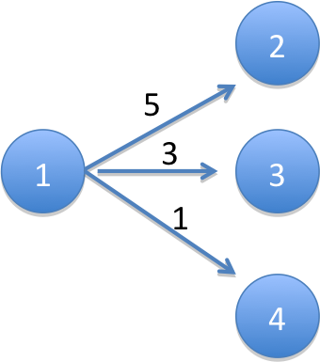
Directed Weighted Edge Graphs
Arc (x_{ij} = 1): if there was an interaction between i and j within a given time period and i initiated that interaction (e.g., a call from i to j)
Outflow Parameter (m_{ij}): Count of the number of interactions between i and j that were initiated by i in a given time period (e.g., number of calls made by i to j)
x₁₂ = x₁₃ = x₁₄ = 1
m₁₂ = 5
m₁₃ = 3
m₁₄ = 1

Slide 9


Node Level Properties
Out-degree (d_{i}): count of number of j nodes that i has initiated interaction with in a given time period (e.g., number of people i called)
Vertex Strength (m_{i+}): activity level of a node, i.e. Count of the number of interactions initiated by i with all i’s j neighbors in a given time period (e.g., total number of calls made by i)
d₁ = 3
m₁₊ = 5+3+1 = 9

Slide 10


Arc Flows & Vertex Stregth
conditional transition probability: probability, given that an event has been initiated by i, that it is with j.
p₁₂ = 5/9 = .556
p₁₃ = 3/9 = .333
p₁₄ = 1/9 = .111
m₁₂ = (m₁₊) (p₁₂)
5 = 9*(5/9)

Slide 11

Tie (Arc) Strength
Arc Flow: m_{ij} = (m_{i+}) (p_{ij})
Transition Probability: p_{ij}
Relative Strength: m_{ij}/max(m_{ik})
Vertex Strength: m_{i+}
Dyadic Edge Strength
(bandwidth)

Slide 12
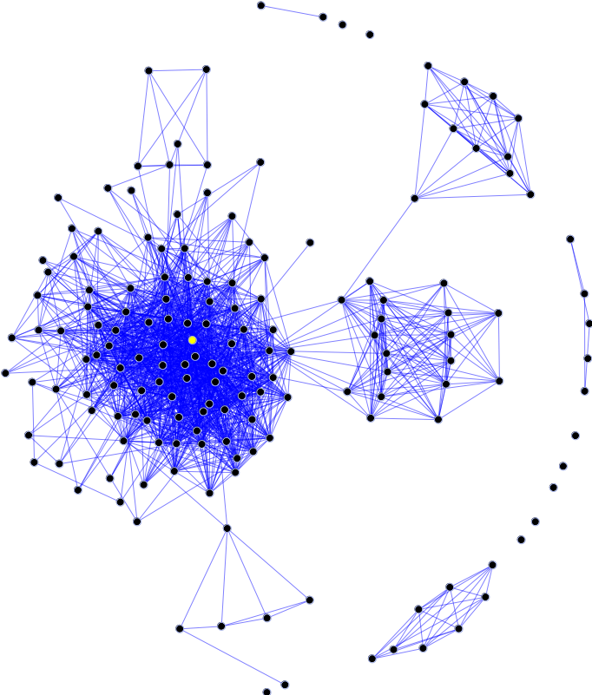
Three perspectives on dyadic change
Assortative
  Actor-attribute match
Relational
  Dyadic embeddedness in larger network structures
Proximity
  Organization of interaction in time and space

Slide 13

Three perspectives on dyadic change
Assortative
  Relations form between similar others
  Do actors always prefer similarity?
    Balance between difference and similarity
    Helps to explain network evolution
Why homophily?
  Trust
  Belief concordance
  Attachment
  Friendship

Slide 14

Three perspectives on dyadic change
Not all attributes created the same
  Rare attributes more conducive to homophily than common ones
Not all ties created the same
  Homophilous relationships more stable than non-homophilous ones
    Romance, marriage, Friends, digital media

Slide 15

Three perspectives on dyadic change
What happens when ties don’t match?
  Forced diversification
    Diversity policies
  Diversity by choice
    Collaborations
    Teamwork
    Complementarity
    Alliances
    Inter-organizational networks
  “Multiform heterogeneity”

Slide 16
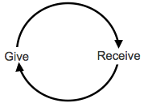
Three perspectives on dyadic change
Relational mechanisms
  Reciprocity
    Ties tend to be reciprocated
    Otherwise they decay
  Links between reciprocity and homophily?
  Contextual effects on reciprocity?

Slide 17
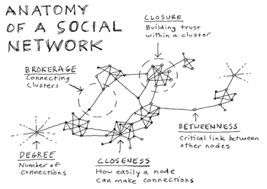
Three perspectives on dyadic change
Dynamic reciprocity:
  Repeated interactions
    Sign of trust
    Mutual Positive Regard
    Friendship
Clustering and Closure
  Friends of friends are also friends
  Close triad promote trust and attachment
  Open triads tend to close

Slide 18
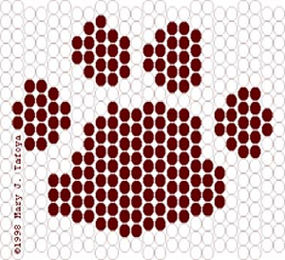
Three perspectives on dyadic change
Proximity Mechanisms
  Spatial Location matters
    Dorms
    Organizational units
  Effects on Formation
  Effects on Persistence
Geographic mobility
  Loss of shared foci
  Tie dissolution

